Slide 1
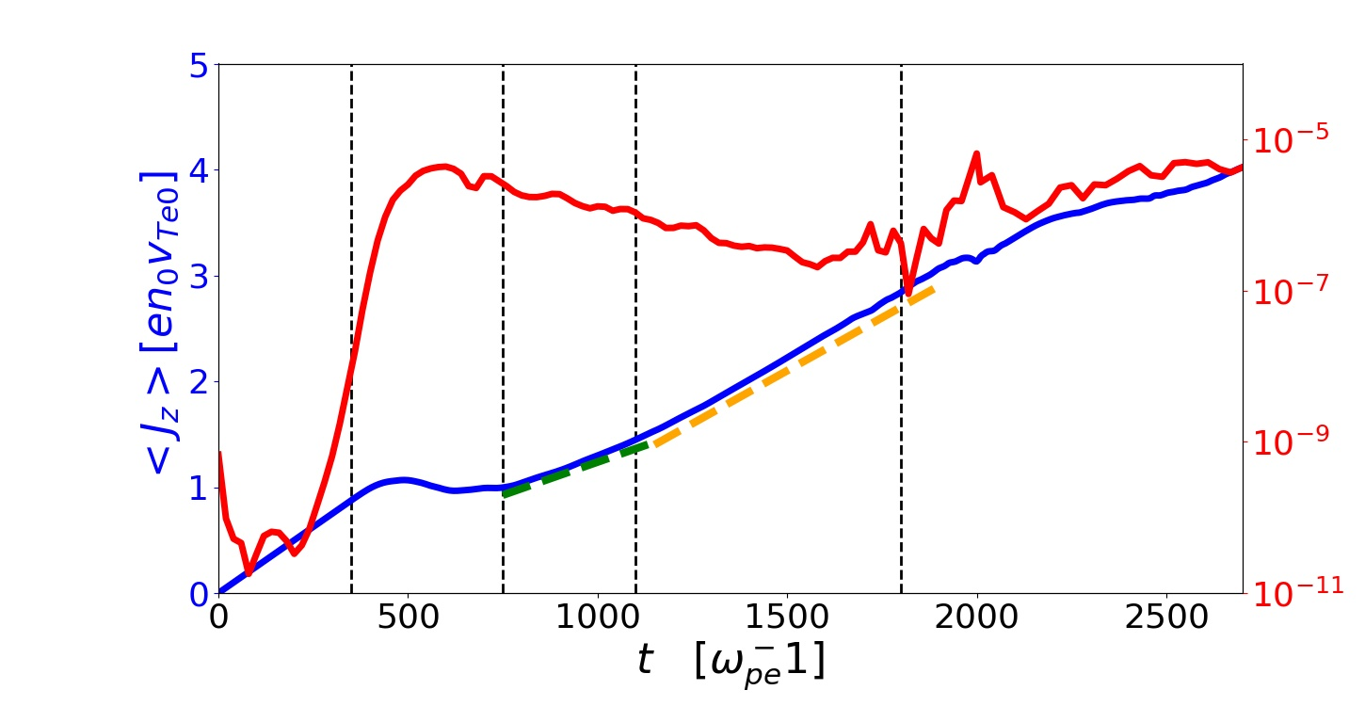
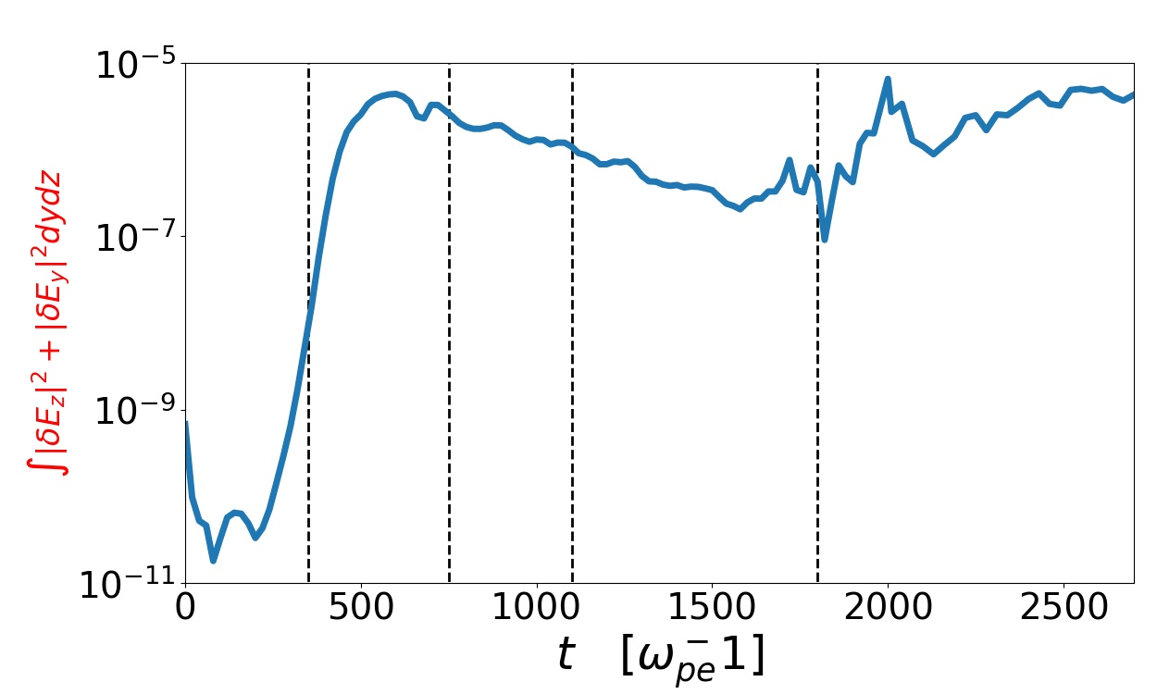
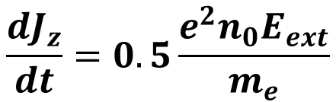
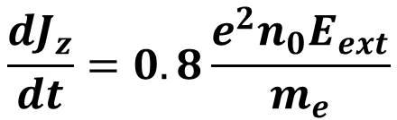
I
II
III
IV
V
electron-electron
instability
$$\frac{dJ_{z}}{dt}=0.8\frac{e^{2}n_{0}E_{ext}}{m_{e}}$$
$$\frac{dJ_{z}}{dt}=0.5\frac{e^{2}n_{0}E_{ext}}{m_{e}}$$

